Slide 1
Navigating the IRB
Jessica L. Yoos, MA, CIP
IRB Assistant Director
Office of Regulatory Affairs
Notes:
Conference Call notes
Residents and Fellows, all MDs
7-10 slides for 20 minutes
Timing for questions: 10 minutes for Q&A
Show up 15 minutes before session

Slide 2
Agenda
Our goal and mission / approach
Levels of IRB review
  Types of studies that qualify
Criteria for Approval
Consent and HIPAA Authorization
HSERA
Submission Tips
Questions

Slide 3
What is an Institutional Review Board (IRB)?
An ethics committee
What does the IRB do?
  Formally review, approve, and monitor human subjects research to ensure the safety, rights, and welfare of subjects are protected
IRBs are also tasked with determining the degree and likelihood of risk
  Minimal risk: “the probability and magnitude of harm or discomfort anticipated … are not greater … than those ordinarily encountered in daily life or during … routine physical or psychological examinations or tests.”
Minimal
Greater than minimal
Notes:
Penn has 7 biomedical committees with a variety of expertise.
The IRB determines the risk of the study as defined by the DHHS definition of minimal risk.

Slide 4
Levels of IRB Review
NHSR
Exempt / Limited Review
Expedited Review
Convened Board Review
Notes:
NHSR does not require review
Exempt refers to outlined exempt categories per DHHS regulations. Submission is required via HSERA
Expedited refers to outlined expedited categories per DHHS regulations. Expedited means this is a delegated review.
Convened boards review anything that does not fall under exempt and expedited categories and anything that is GTMR

Slide 5
Types of Studies: NHSR, exempt, and expedited
Exampled of Exempt Studies
Examples of Expedited Studies
Research with drug and device products that is exempt from FDA IND & IDE regulations
Not Human Subjects Research (NHSR)
Not Research Example:
Case study of 3 or fewer patients
Using existing publicly available data (e.g., anyone can download from internet)
Benign behavioral interventions with adults
Secondary research with existing, non-sensitive data or specimens
Surveys/ interviews/ focus groups with adults collecting non-sensitive data
Limited datasets from data registries or research studies
Chart reviews
Receiving de-identified data or specimens where no link exists with identifiers
Research involving cadavers
Venous or fingerstick blood collection considering frequency, amount, and subject
Non-invasive collection of saliva, hair, nails, teeth, skin swab, sputum, etc.
Collection of data via non-invasive means (e.g., MRI without contrast, EEG, ECG, pulse ox, etc.)
Risks must be minimal
Not involving HS Examples:
Quality Improvement
Educational Project
Notes:
NHSR: As defined by DHHS: “Research is a systematic investigation, including research development, testing and evaluation, designed to develop or contribute to generalizable knowledge.” Therefore, to meet this qualification the project would need to be determined to not be research OR not involve human subjects.
FDA regulations defines a human subject to be an individual (healthy volunteer or patient) who is a recipient of an FDA regulated product (e.g., drug, biologic, device, dietary supplement, etc.) or a control.

Slide 6
How does the IRB determine approval?
Criteria for Approval
Risks to subjects are minimized
Equitable subject selection
Adequate protections to protect privacy and confidentiality
Additional safeguards for vulnerable subjects
Risks are reasonable in relation to benefits
Consent will be sought / documented
Notes:
This is important for researchers to understand so they can go through the process more smoothly.

Slide 7
Consent and HIPAA Authorization
Informed Consent/ HIPAA
Administering a drug or device for research purposes
Administering a clinical or behavioral intervention
Alteration of IC/ HIPAA
Must be minimal risk as determined by the IRB
Participants given option to opt out because intervention is being implemented across a whole hospital or health system
Waiver of Documentation of IC
Retrospective chart review
Collection of leftover tissue usually discarded
Waiver of IC and HIPAA
Interviews, Focus Groups, Surveys, Questionnaires
Prospective chart review plus phone survey
Non-invasive collection of such as saliva, teeth, etc.
Notes:
There are certain criteria for waivers or alterations. However, our forms walk you through all that.

Slide 8
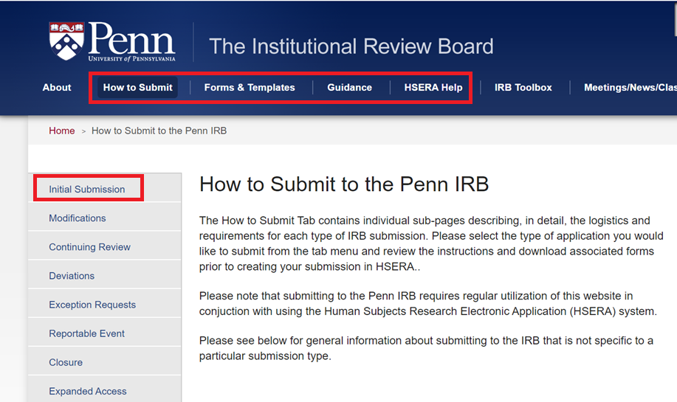
IRB Guidance: irb.upenn.edu
Notes:
Very brief slide (explaining the difference between the website and HSERA)

Slide 9
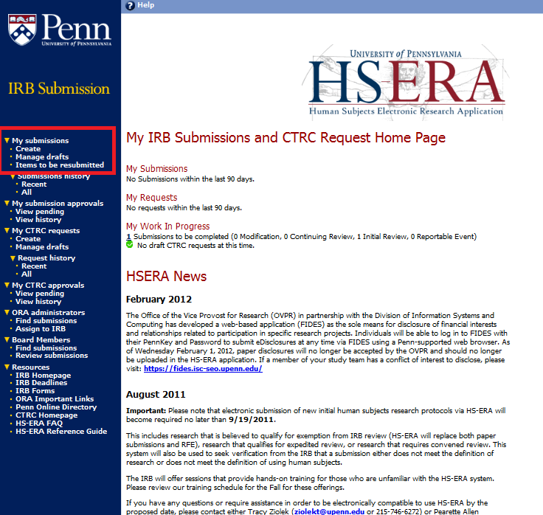
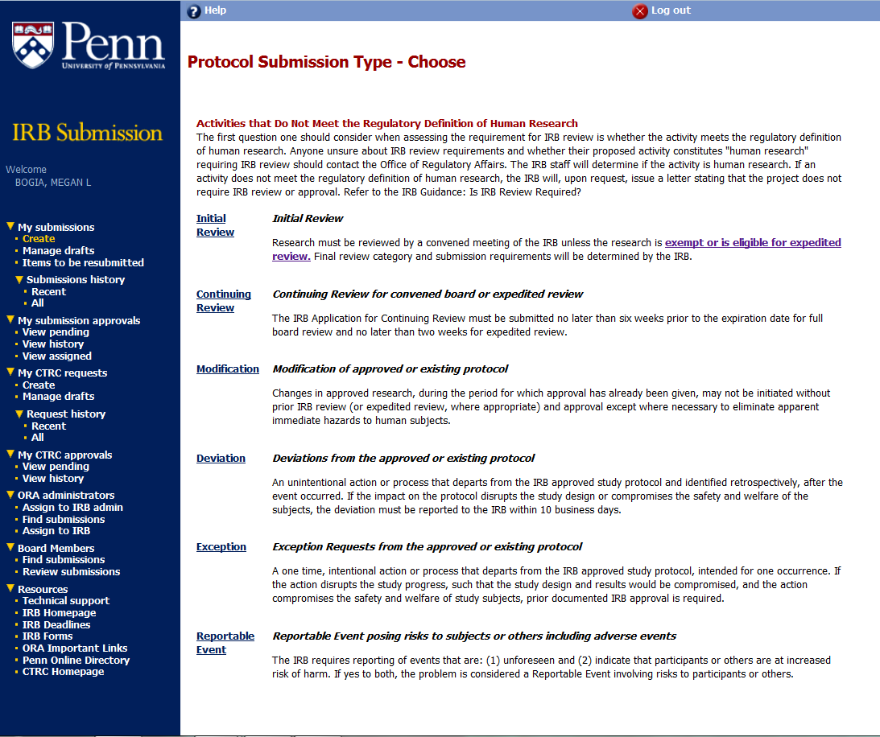
IRB Application: hsera.apps.upenn.edu
Notes:
Very brief slide
Penn-specific online platform for exempt, expedited, and FB submissions

Slide 10
Best Practices
Review Submission Guidance on our website
Tell us what you want to do
Make sure everyone has taken their CITI training
Utilize our template protocols & consent forms
Don’t repeat.
Use simple language in consents and application
Don't leave blank space in HSERA. Refer to Section # in Protocol
Provide rationale
Give yourself enough time & don't rush

Slide 11
Best Practices Continued
Complex and/or Greater than Minimal Risk Research
  Utilize a protocol template from our website
  Clearly delineate research aspects from usual care: required by the protocol = research
  Consider whether independent safety monitoring is appropriate based on the risk
If administering a drug or device product, the study can only be reviewed at the expedited level if:
  The protocol qualifies for an exemption from FDA IND and IDE regulations, AND
  The protocol is minimal risk

Slide 12
Other Educational Options
Come to IRB Office Hours with specific questions: Thursdays 10am-12pm
Join as a convened board IRB member for more experience!
    Commitment Details:
      Full time: 8 meetings a year, or
      Alternate: attend meetings as needed (e.g., 3-4 mtgs per year), or
      Serve as a consultant reviewer
      Flexible attendance options: tele-conference or video-conference
Benefits
      Improved knowledge of IRB processes facilitates IRB submissions
      Exposure to new research topics, designs and technologies in various fields
      New networking opportunities with faculty, staff, and students in related fields
Interested? Email me: jessyoos@upenn.edu

